Slide 1

Drought impact
reporting - National
Drought Monitoring
System in Czech
Republic
Monika Bláhová
Global Change Research Institute CAS
blahova.m@czechglobe.cz

Slide 2

Agenda
• Czech drought monitoring system and global drought monitoring
products
• National reporting network (NRN)
• Development of Czech NRN
• NRN examples from Slovakia and DriDanube project
• How to engage reporters and kick-start your NRN
• Why is this important? How to use communicate your results?

Slide 3

1. Intersucho.cz –
Czech National
Drought Monitoring

Slide 4
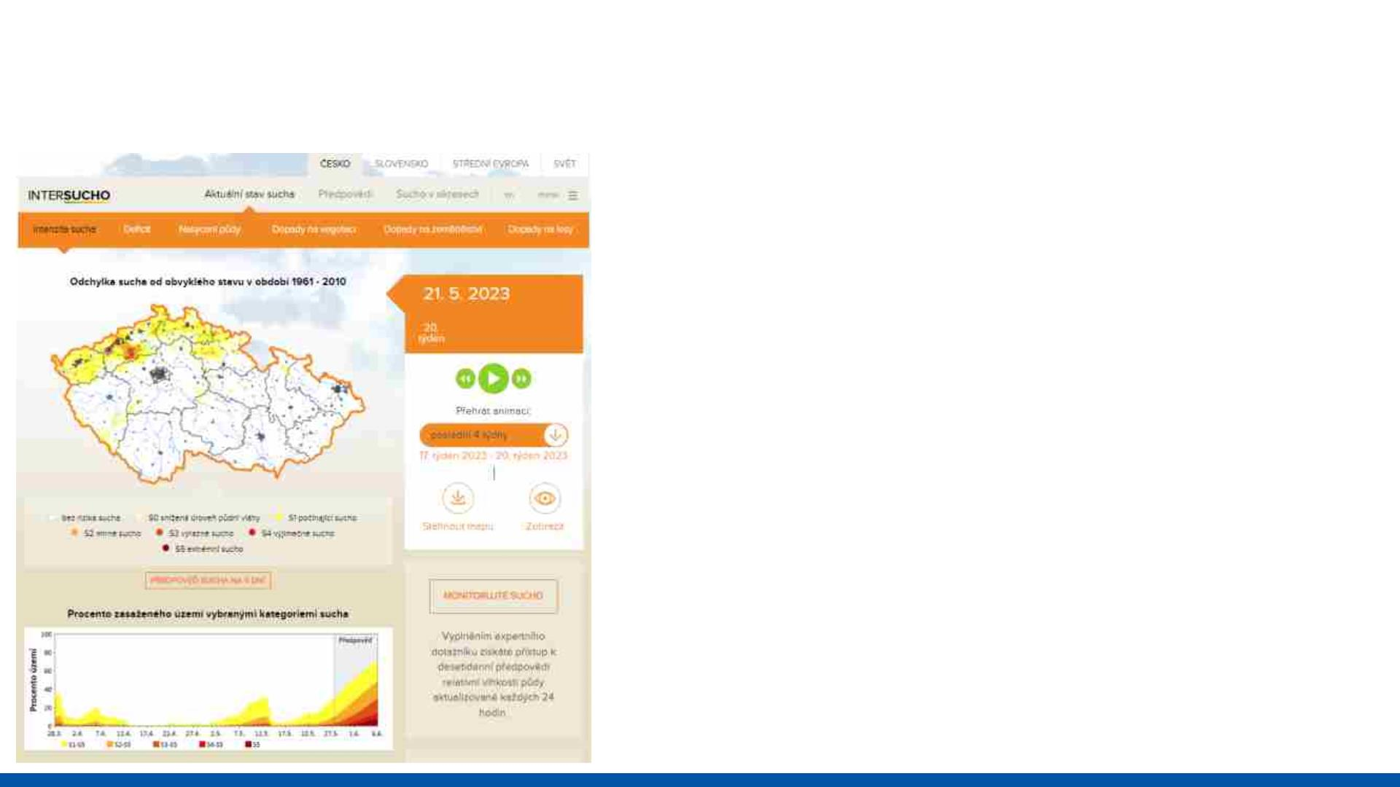
Intersucho.cz – Czech Drought Monitoring
• Daily and weekly drought
monitoring and prediction products
• Soil (agricultural drought)
• 500 x 500 m spatial resolution
• Czechia, Slovakia, Central Europe,
Global
• 2012
• Comrehensive drought evaluation
• www.intersucho.cz
• www.windy.com

Slide 5
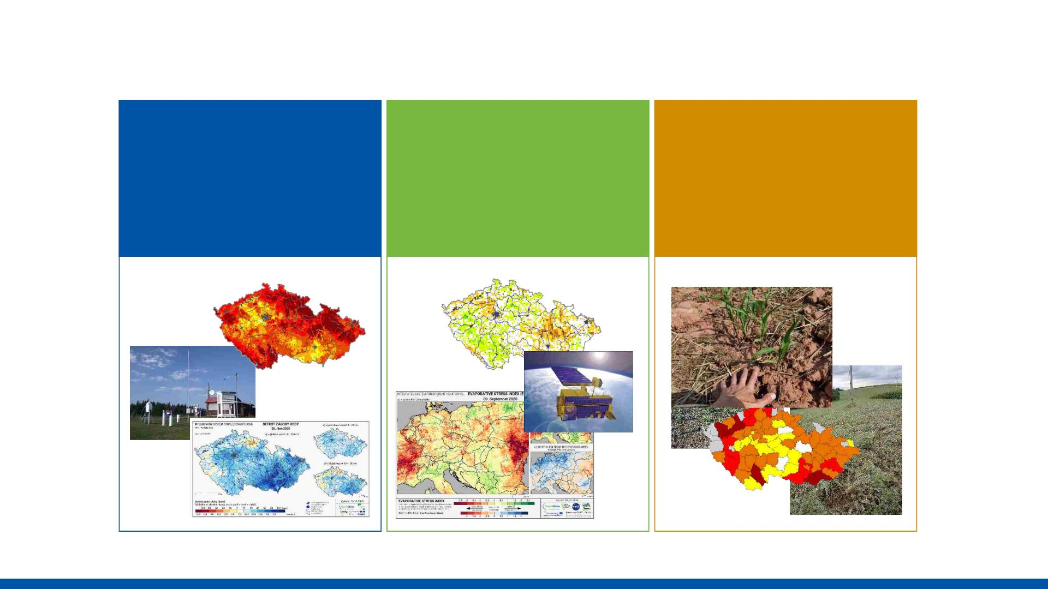
Intersucho.cz – Comprehensive drought monitoring
SoilClim water
balance
Remote
sensing
products
National
reporting
network
model

Slide 6
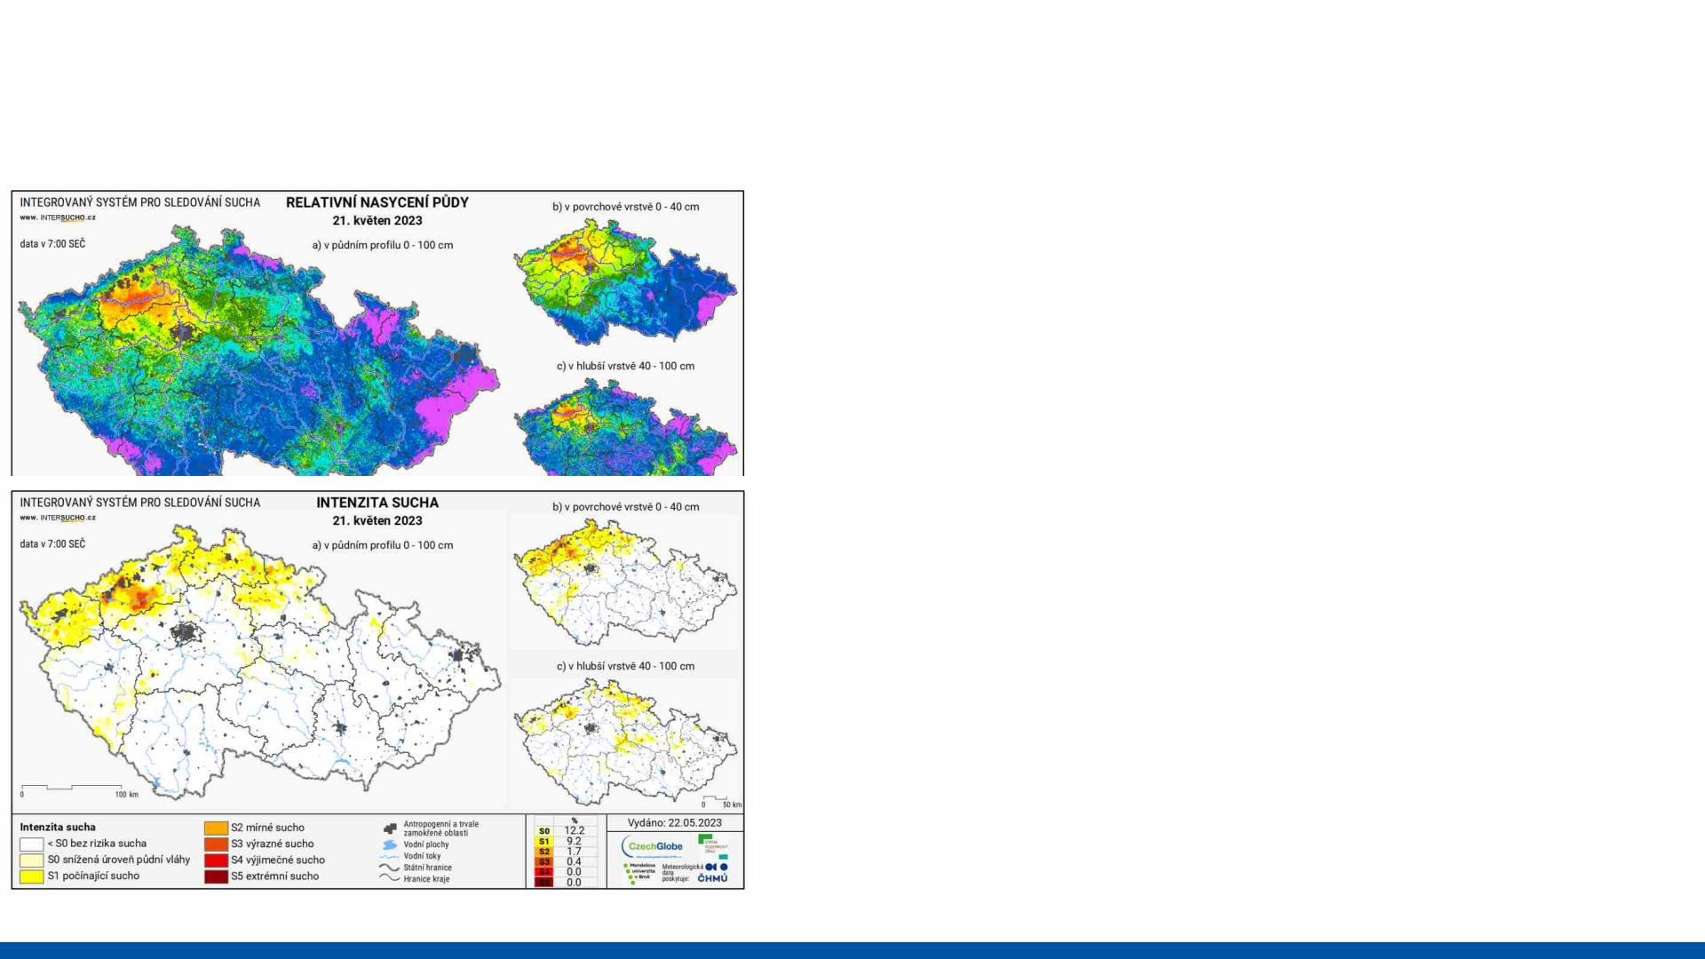
Intersucho.cz - SoilClim
• Water balance model
• 0-40, 40-100, 0-100 cm
• Meteorological inputs from the
station network, soil properties, land
cover
• 500 x 500 m spatial data outputs
• Daily
• Including mid-range prediction and
statistical prognosis for up to 6
months

Slide 7
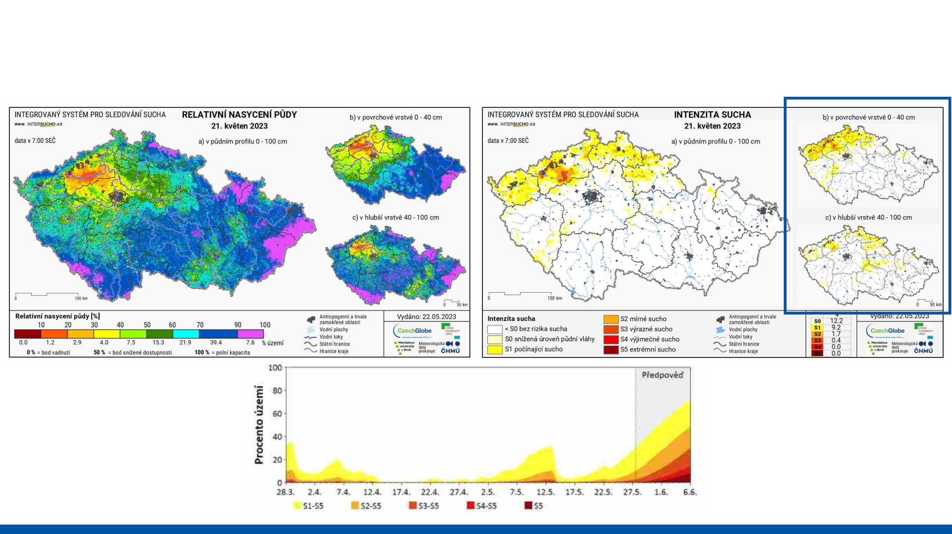
Intersucho.cz - SoilClim

Slide 8
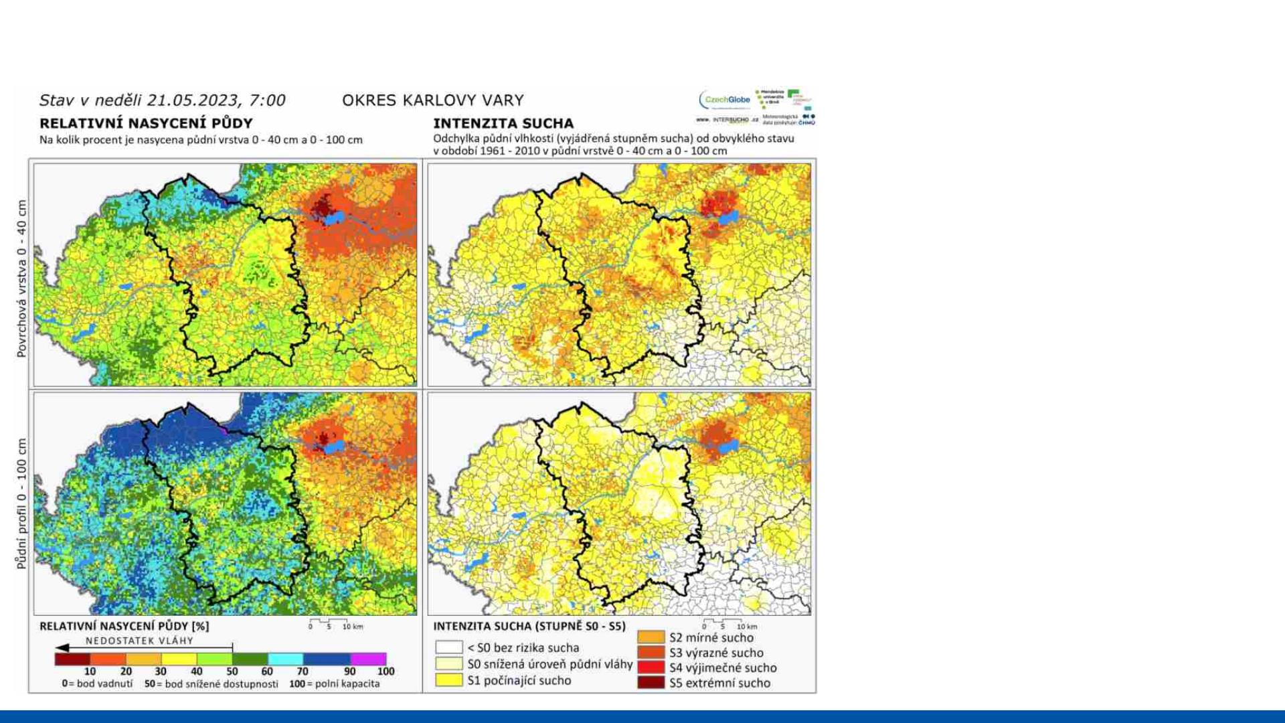
Intersucho.cz - SoilClim

Slide 9
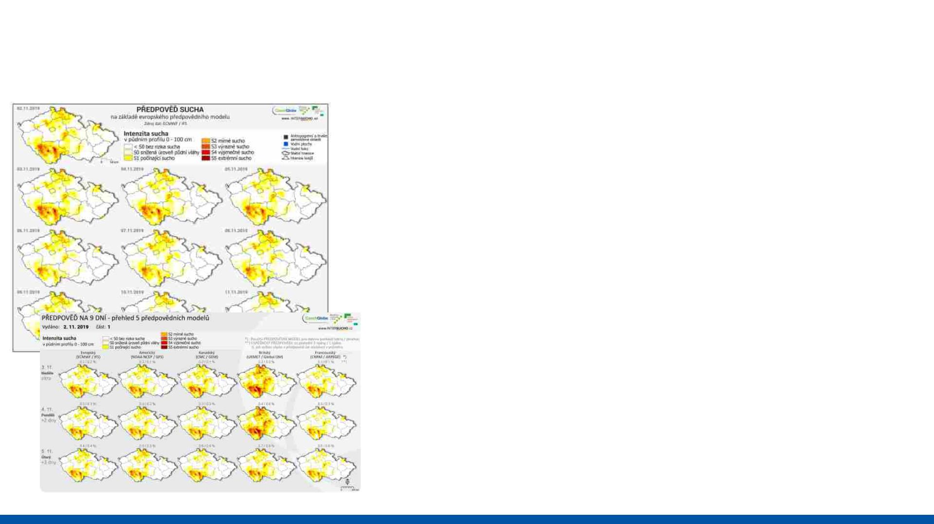
Intersucho.cz – SoilClim prediction
• 9 days of predicted agroclimatic
conditions (T, p) and soil moisture
content
• ECMWF IFS model + 4 other
prediction models
• Publishing daily together with text
information about expected
conditions and risks

Slide 10
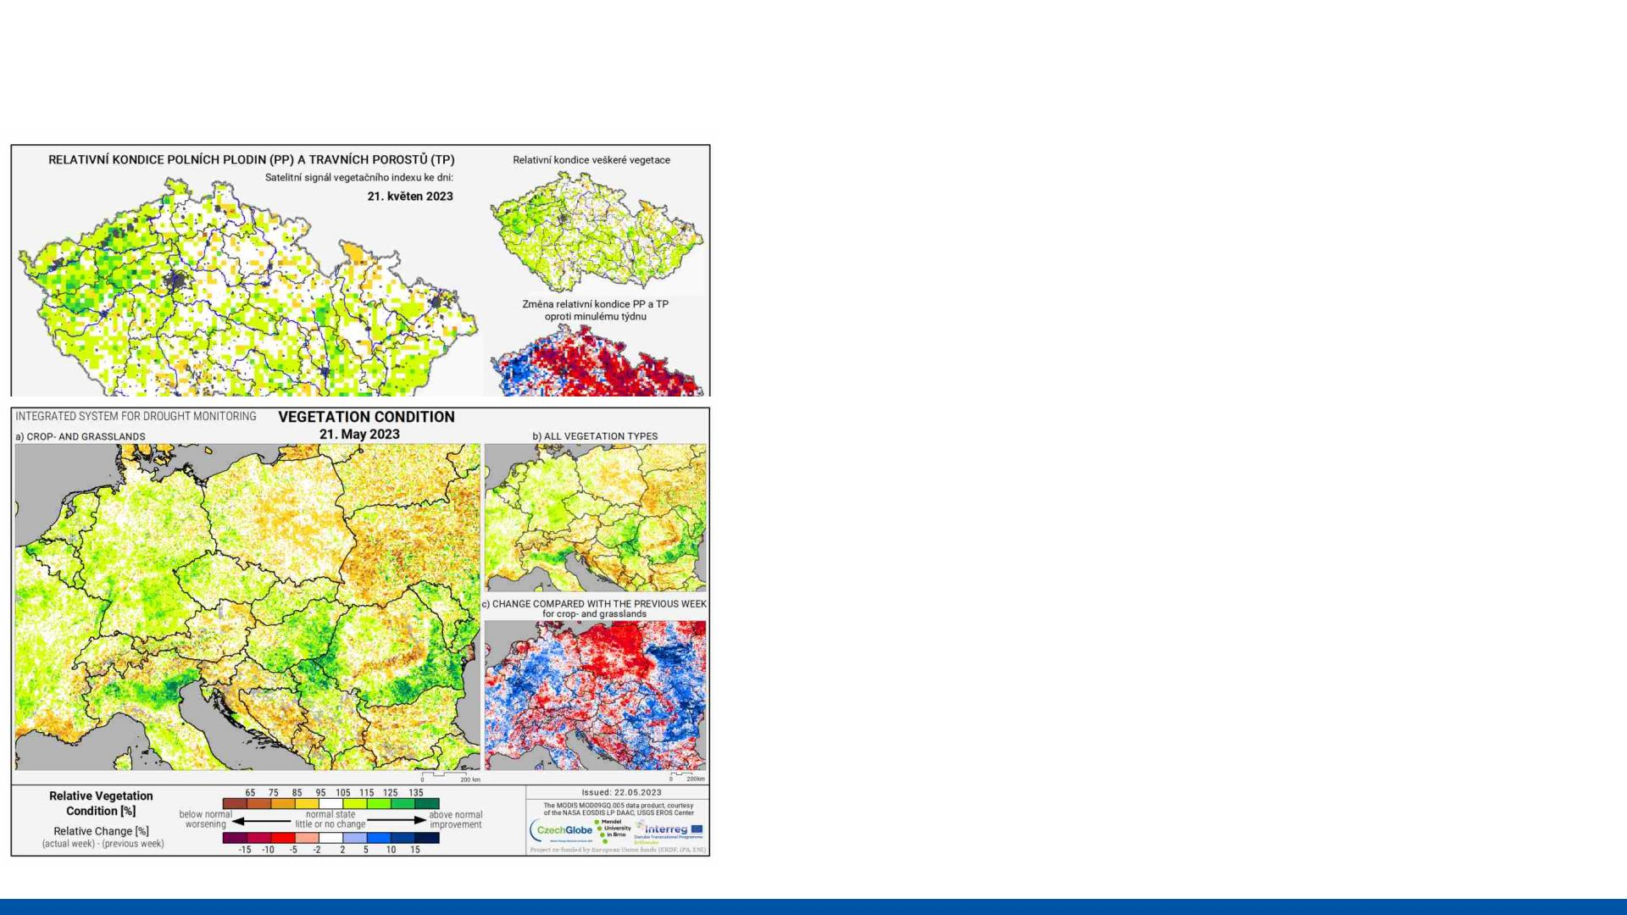
Intersucho.cz – Remote sensing
• Relative soil moisture content,
vegetation condition, evaporative
stress index
• Various sources, spatial resolution,
level of data processing
• Focus on central Europe as well as
Czechia and Slovakia

Slide 11
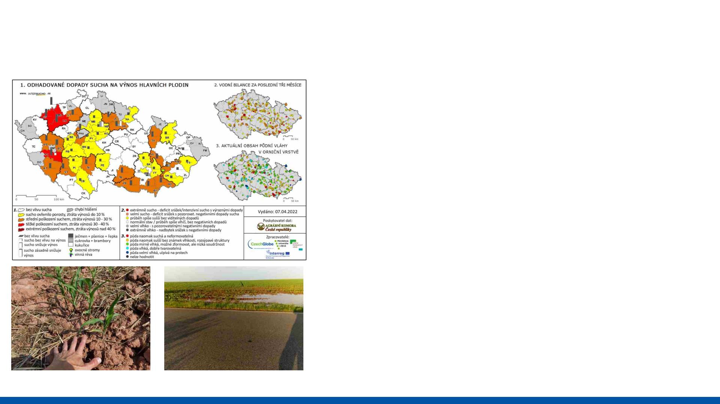
Intersucho.cz – National Reporting Network
• Voluntary group of a few hundred
of reporters
• Agriculturists, Foresters, Fruit growers,
Wine growers, Seedling growers
• Evaluating soil moisture conditions
and change
• Evaluating observed drought
impacts on crops and expected
yield loss
• Simple online questionnaire
• No measuring devices
• Farm level

Slide 12
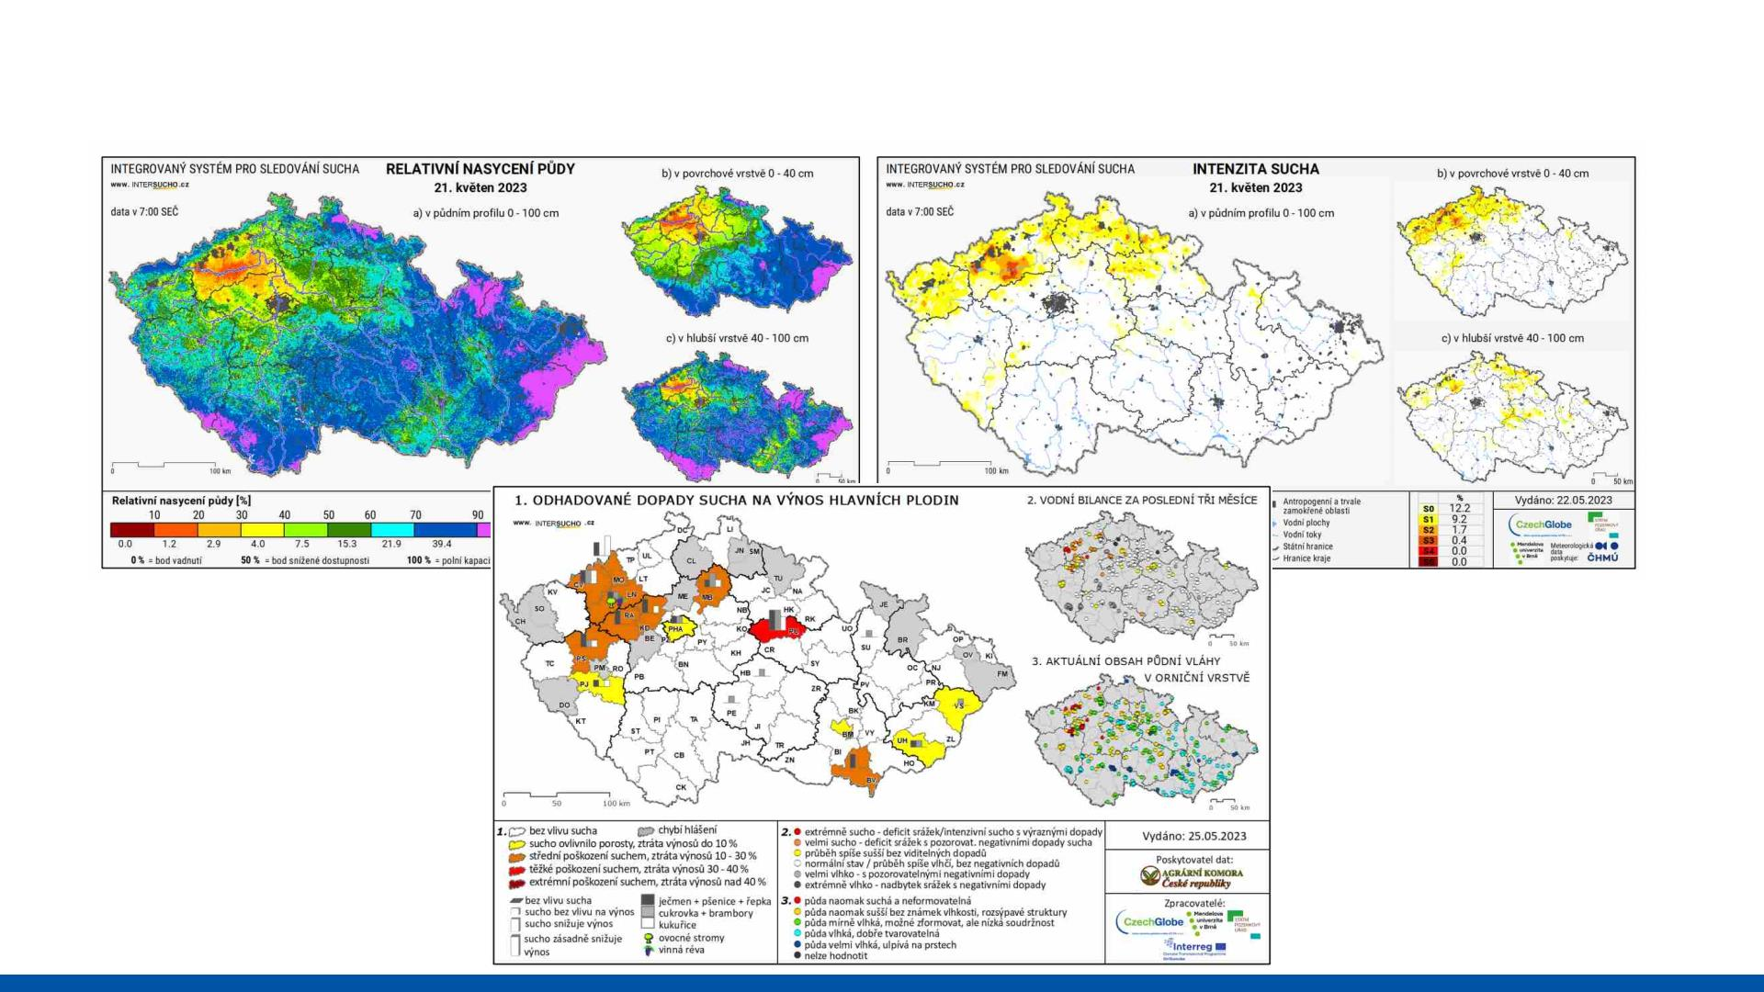
Intersucho.cz – Comprehensive drought view

Slide 13
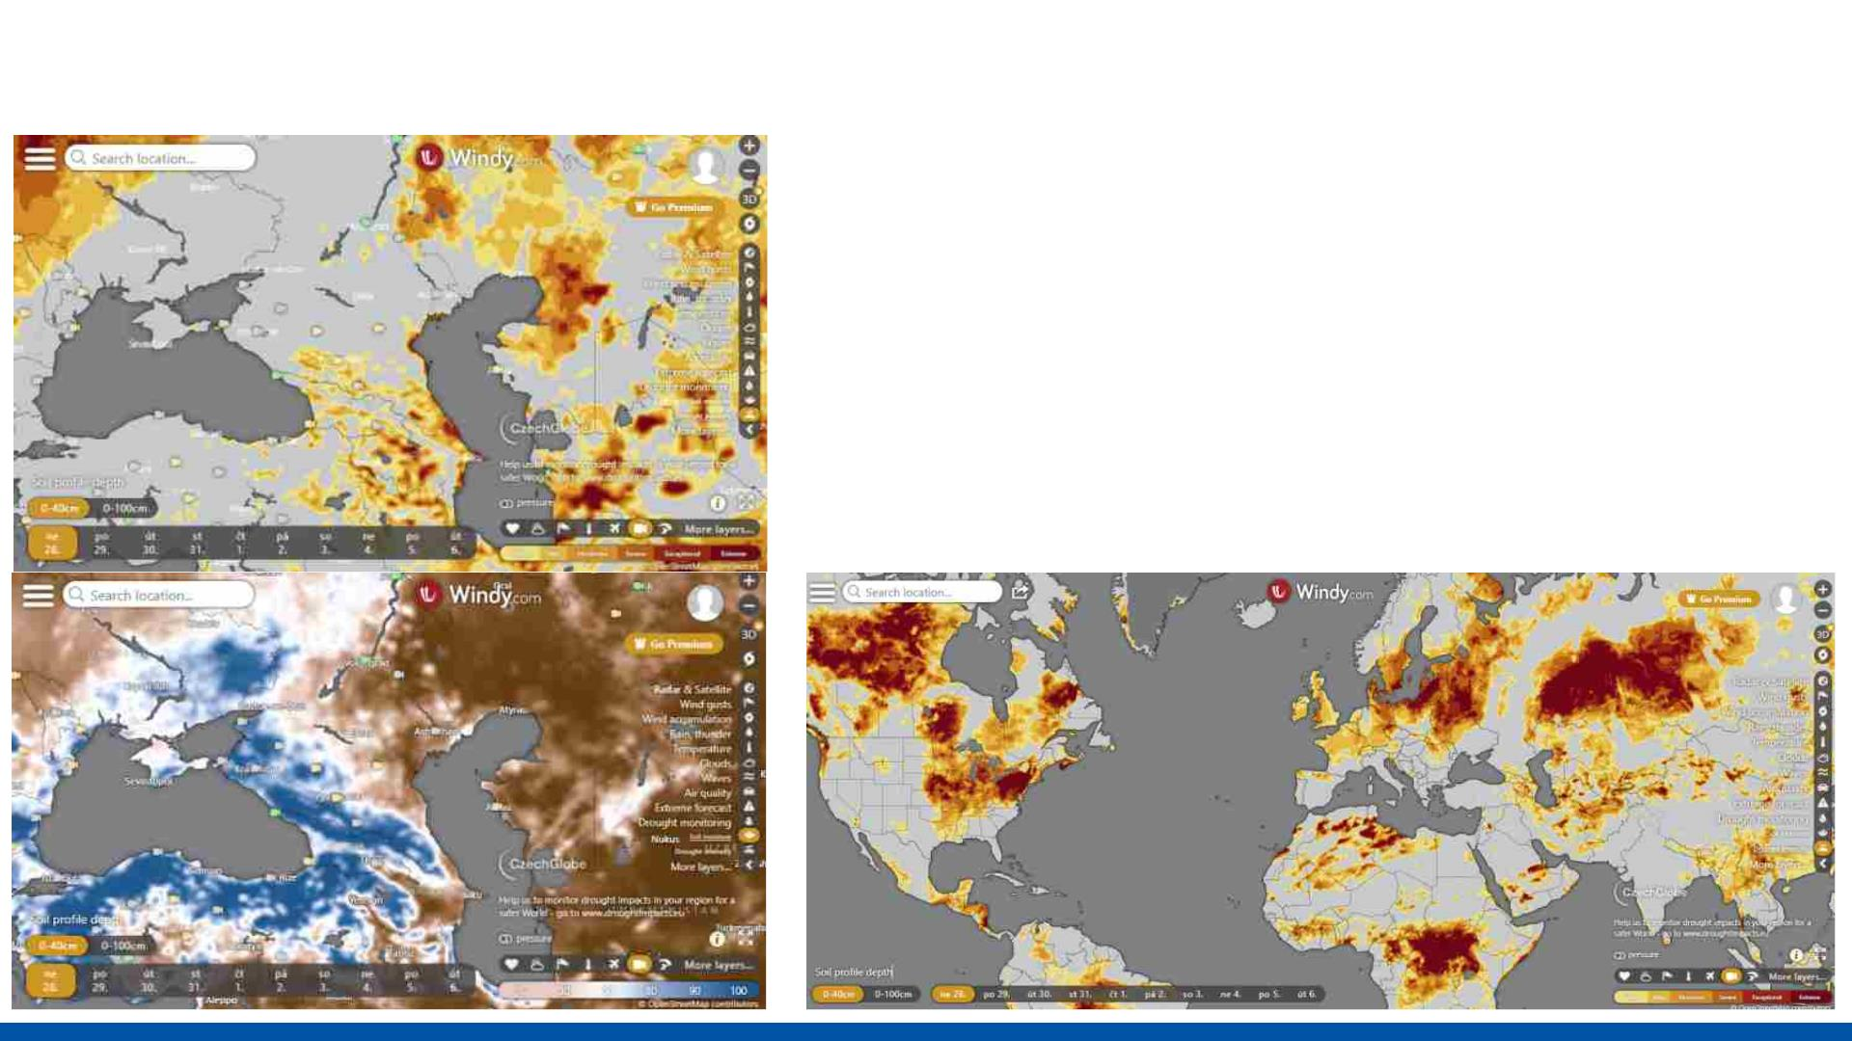
Intersucho.cz – Global SoilClim – windy.com
• Global layers for Drought Intensity
and Relative Soil Moisture content
• 0-40, 0-100 cm
• 9 days of prediction
• Windy.com - > drought monitoring

Slide 14
2. National Drought
Reporting Network

Slide 15

NRN in Czechia
• Voluntary group of active farmers, giving
weekly feedback from their locality
• E_{e}v_{x}a_{p}l_{e}u_{r}a_{ti}t_{s}i_{e}on based on their knowledge and
• No measurements
• Simple online questionnaire
• Available directly from the intersucho
website
• Agriculture
• Fruit growing and viticulture
• Forestry
• Seedlings
• Evaluation + pictures, comments…

Slide 16
NRN in Czechia
• Reporters active since 2015
• First 25 reporters nominated by Czech Agricultural Chamber to
help define and develop the system
• Goal was to have up-to-date information about drought
development, severity, and its impacts on crops
• Include those who are most concerned and impacted by
drought events to the process

Slide 17
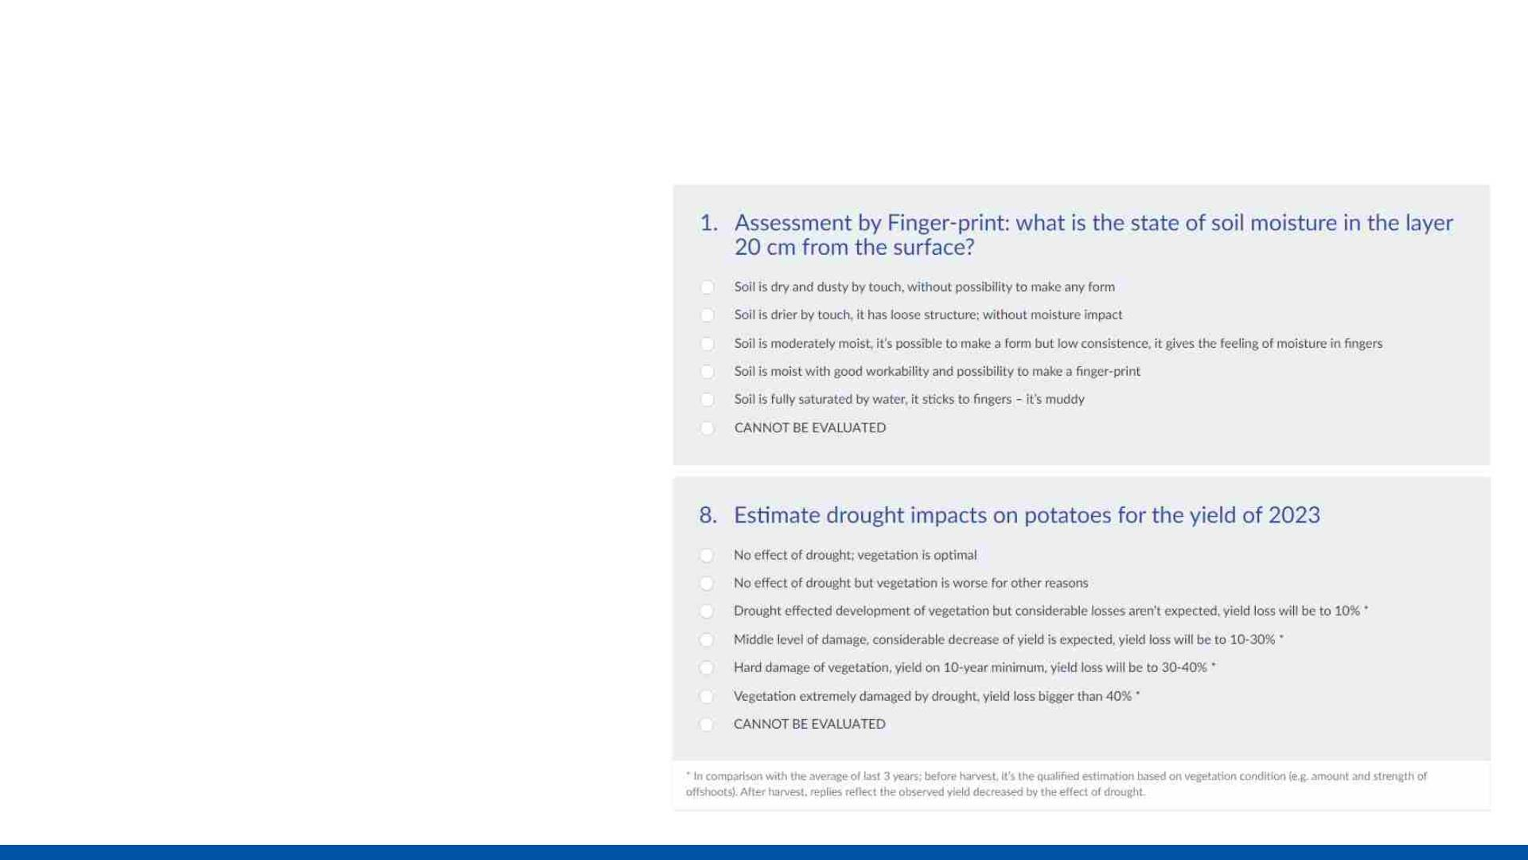
NRN in Czechia – how does it work?
• Online questionnaire
• 4 types
• Agriculture
• Fruit and grape wine
• Forestry
• Seedlings
• 3 parts
• Evaluation of soil moisture
• Drought impacts on crops
• Comments
• Additional information
• Pictures
• Yields
• Phenology

Slide 18
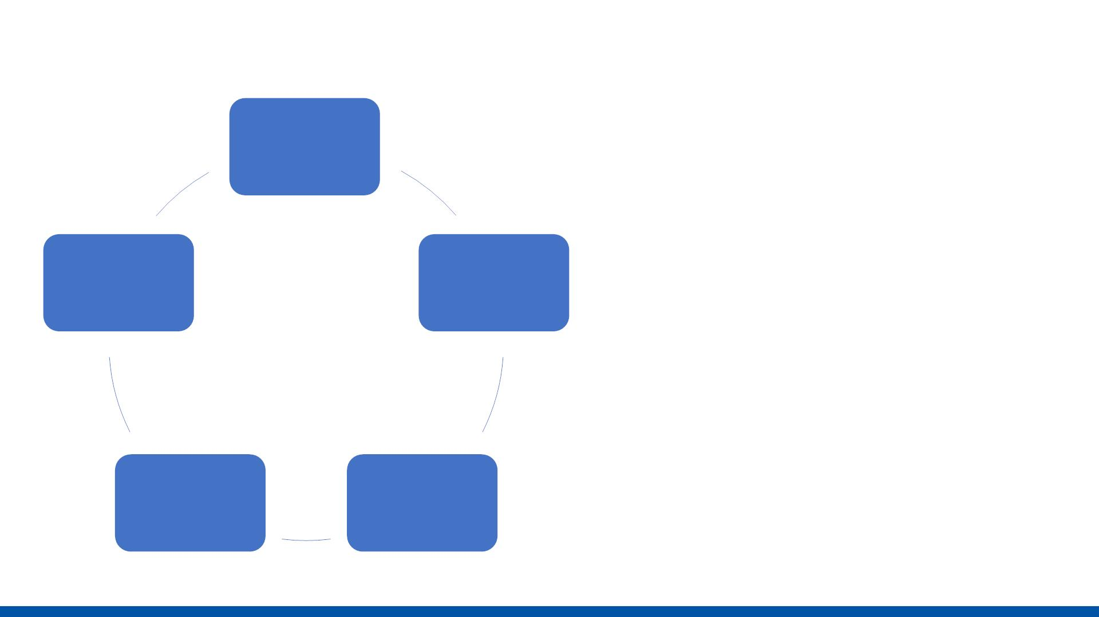
NRN in Czechia – how does it work?
• Weekly evaluating
MO –
questionnaire
opens
• Retrospectively, on the last
week
• Reporters engaged to be
active and send the
questionnaire
FR – text
commentary
uploaded
TU – mail to
all active
reporters
• Weekly data processing,
followed by the mapu and
text commentary upload
TH – new map
produced
TH –
questionnaire
closes

Slide 19
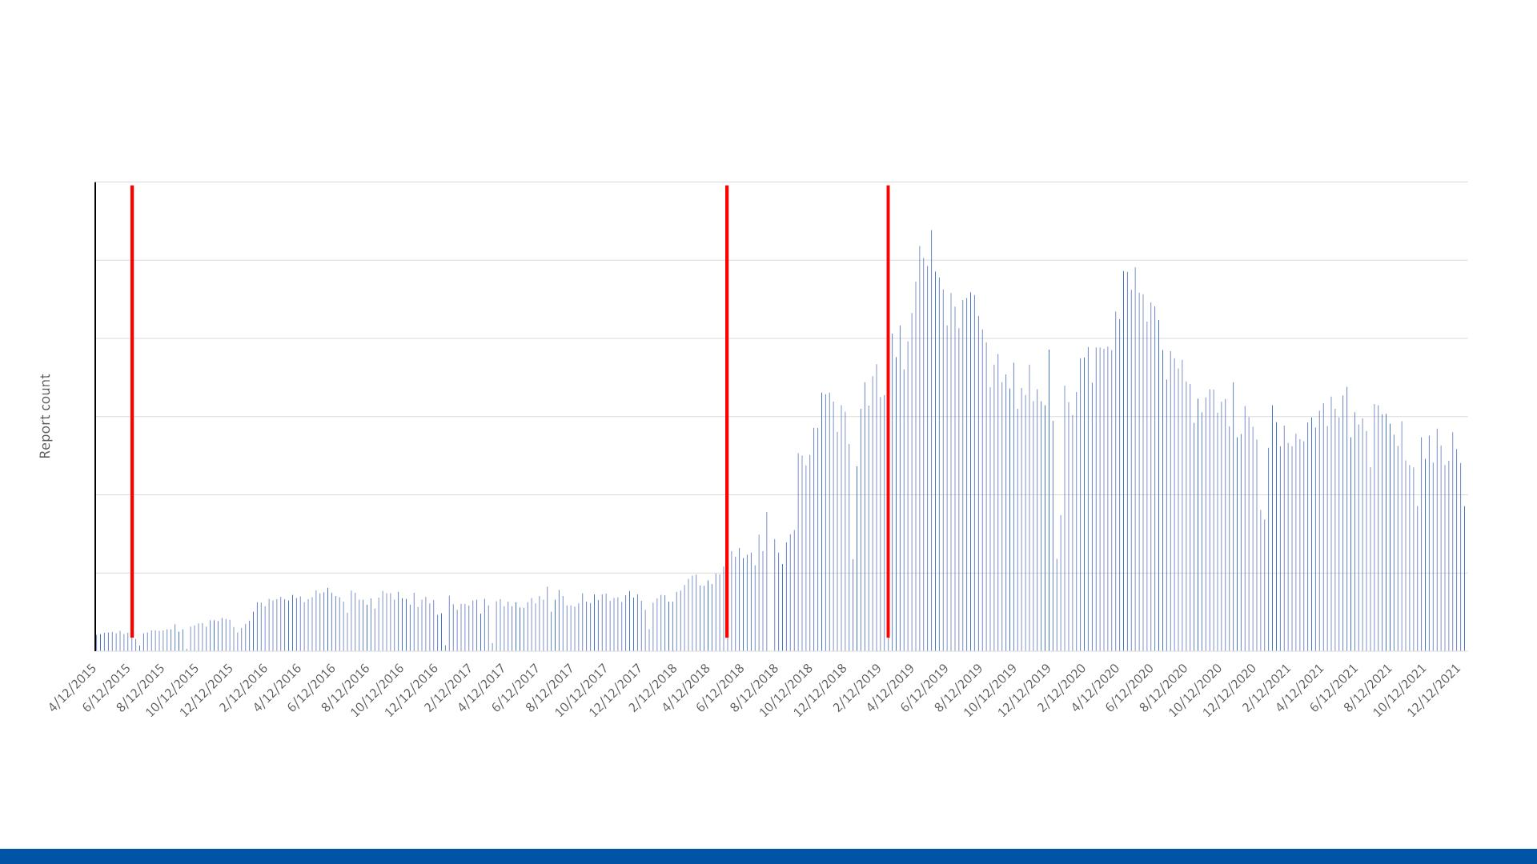
NRN in Czechia
Weekly report count 2015-2021
1200
1000
800
600
400
200
0
Drought
2015
Drought
2018
Drought
2019
Date

Slide 20
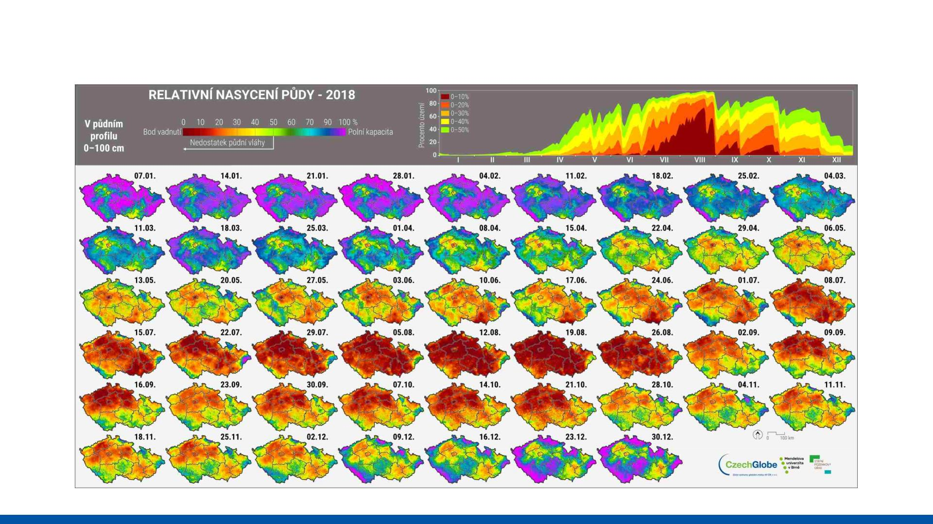
NRN in Czechia – Drought event 2018

Slide 21
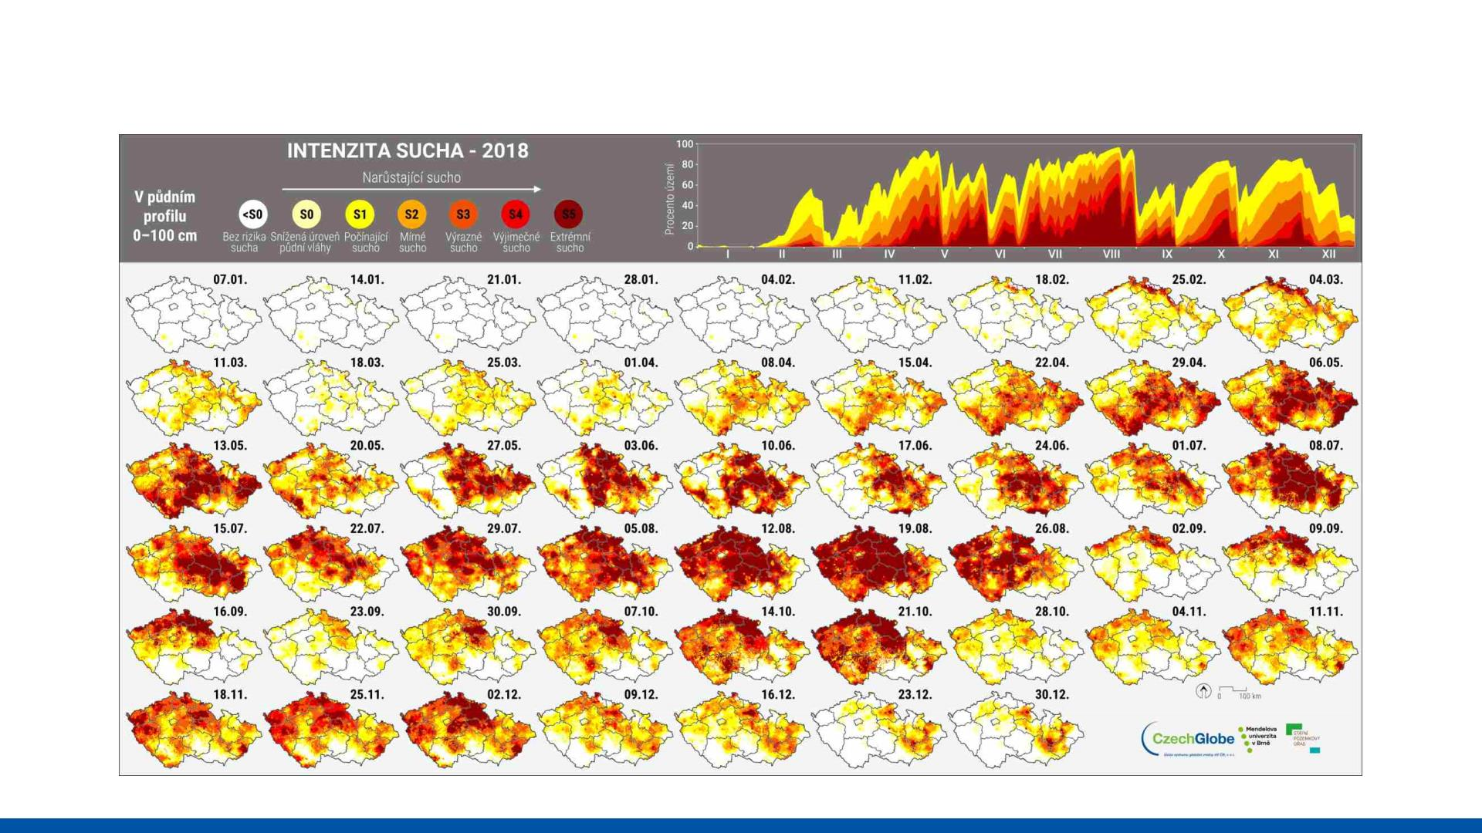
NRN in Czechia – Drought event 2018

Slide 22
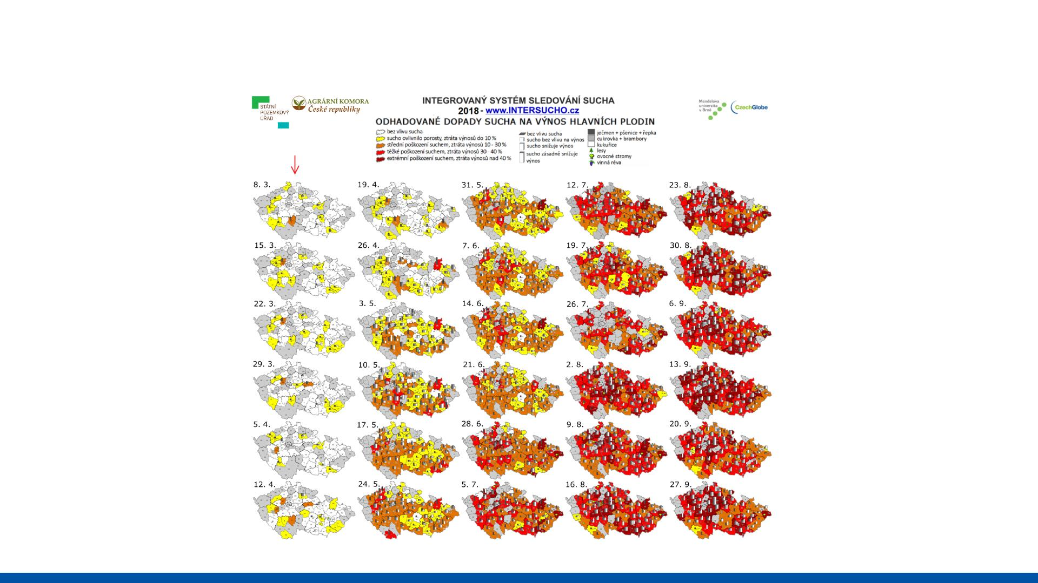
NRN in Czechia – Drought event 2018

Slide 23

NRN in Czechia – Drought event 2018
• Extreme drought event after 3 dry
• Drought reporters taken as
the main source of crop
years
damage and yield loss
• Heavy impacts in yields (cereals, oil
seed rape, potatoes, fodder
information
• Thanks to
production)
• Yield loss of up to 60%
• Decided on drought subsidies for the
•
Already working system
• Regular reporting
agricultural sector
• Consistente damage
reporting
• How to evaluate drought impacts on
farms?
• Consistency between
• Whole country affected; multiple crops
• Paperwork X time
damage reporting and soil
moisture deficiency
• Established connection

Slide 24
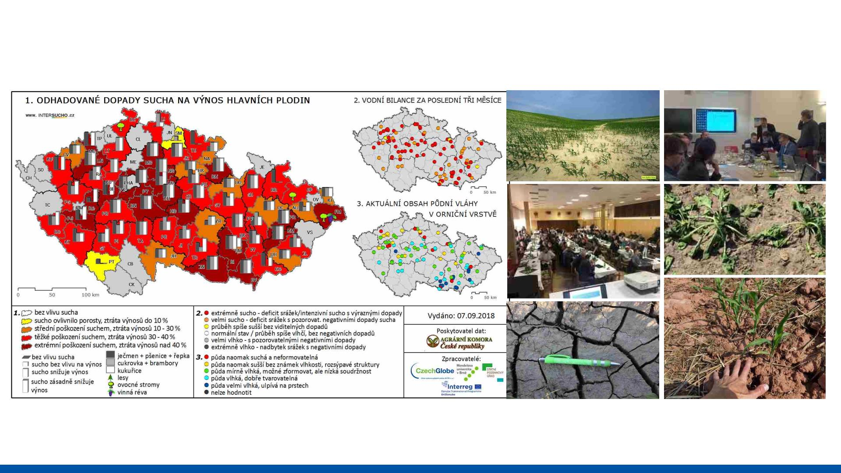
NRN in Czechia – Drought event 2018

Slide 25
3. Working Examples
from other regions

Slide 26
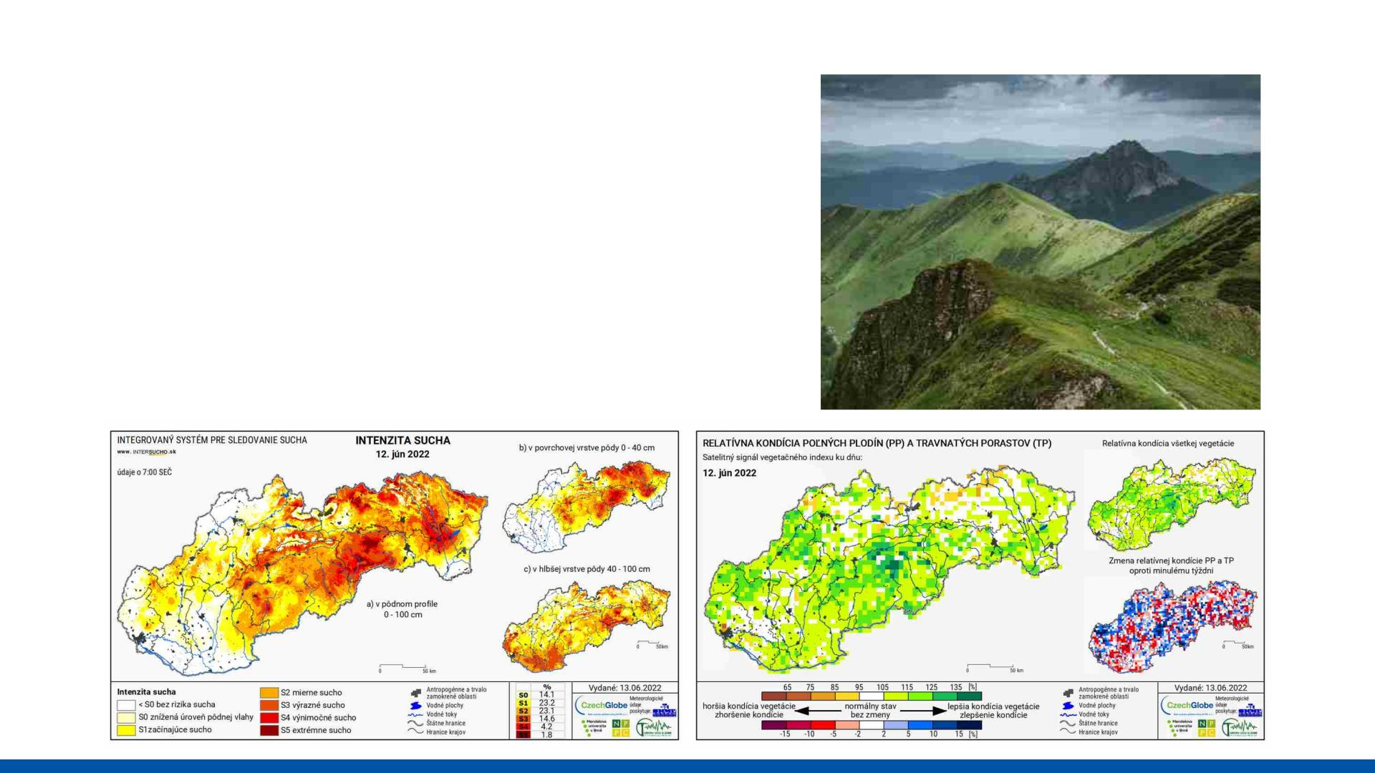
NRN in Slovakia
• Drought monitoring through
Intersucho since 2015
• Reporters active since 2016
• 50 active reporters from fields of
agriculture and fruit growing

Slide 27
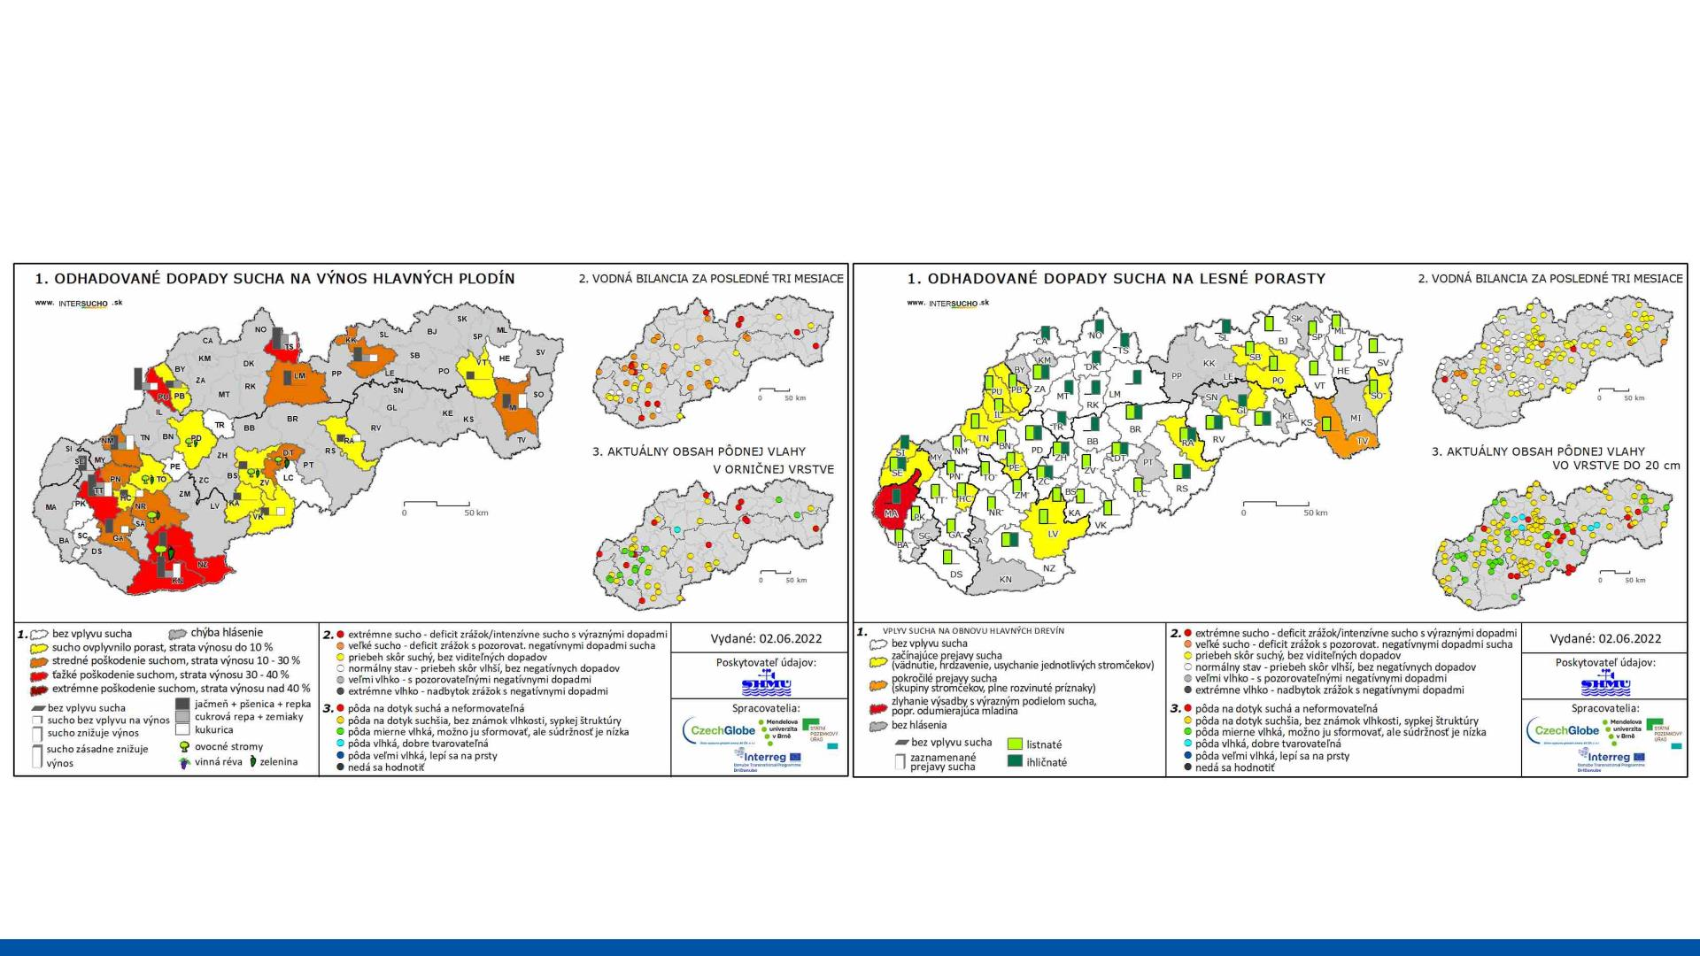
NRN in Slovakia
Agriculture and fruit growing
Forestry

Slide 28
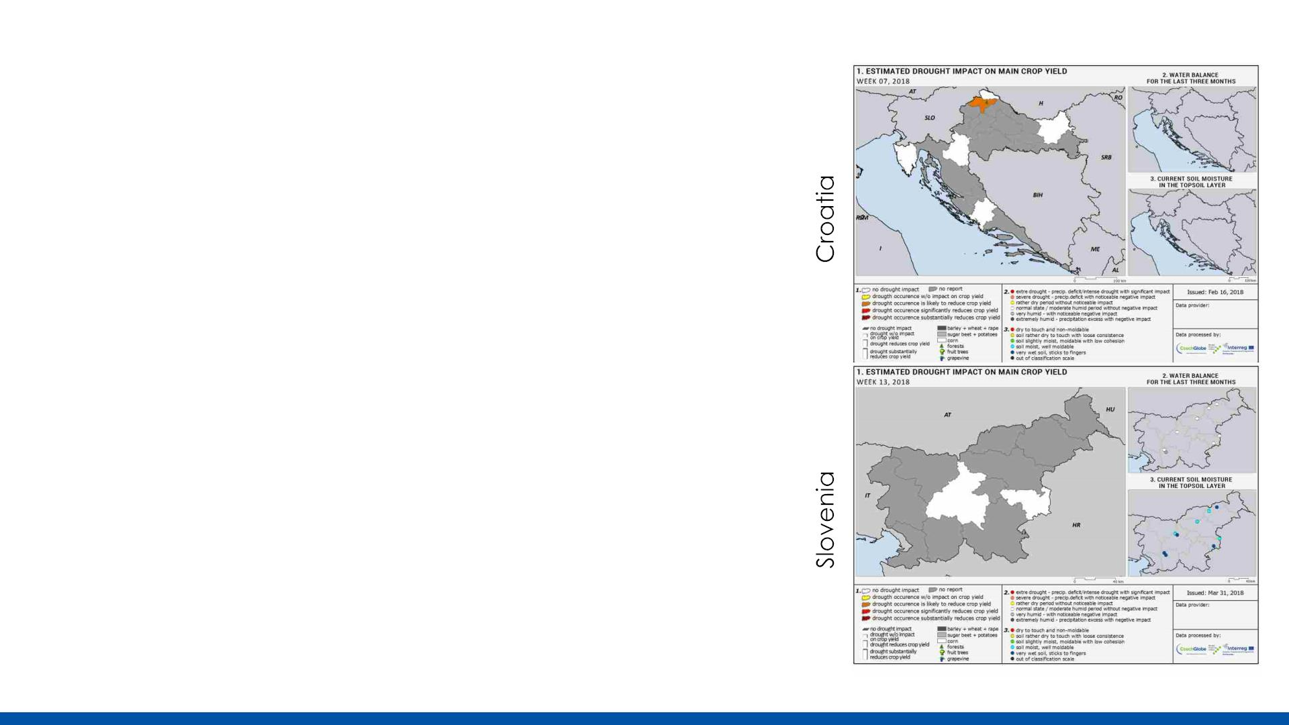
NRN in DriDanube region
• 2017-2019
• Designing the whole system to
cover the needs of a wide and
diverse region
• Online questionnaire in local
languages
• Various countries – various
needs, possibilities, challenges

Slide 29
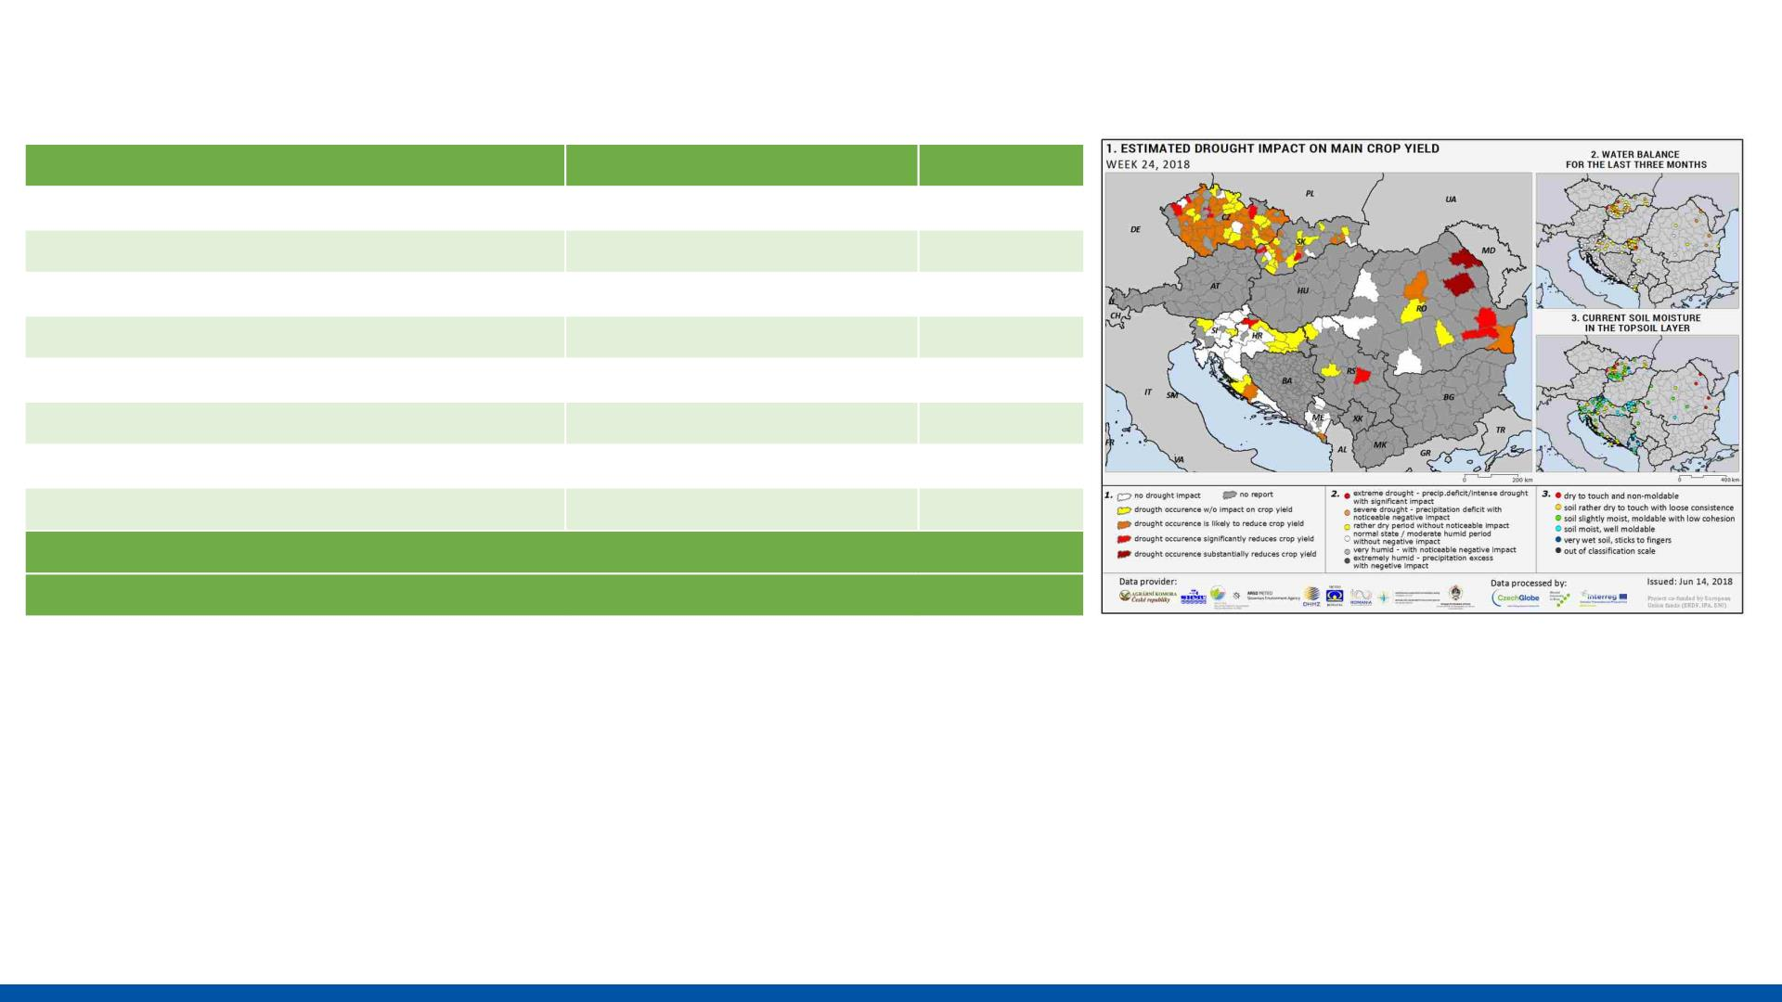
NRN in DriDanube region
Country
Slovenia
Croatia
Number of reporters
Reports
1283
2080
605
76
56
48
34
25
12
12
9
Hungary
Serbia
2346
48
Austria
Romania
573
380
Montenegro
Bosnia and Herzegovina
125
Czech Republic
Slovak Republic
• Over 40000 reports from 10 countries
• Up to 800 weekly active reporters
• Agriculture experts, farmers, foresters, viticulturists, students,
scientists, meteorologists...

Slide 30
4. NRN as a tool of
drought monitoring

Slide 31
NRN for drought monitoring
• We learned that NRN is a viable tool for drought monitoring
• Near real-time information from the most concerned group
• Experienced reporters with a good sense of what is going on
• High level of detail
• Responsive network of contacts
• Feedback on any other drought monitoring tools

Slide 32
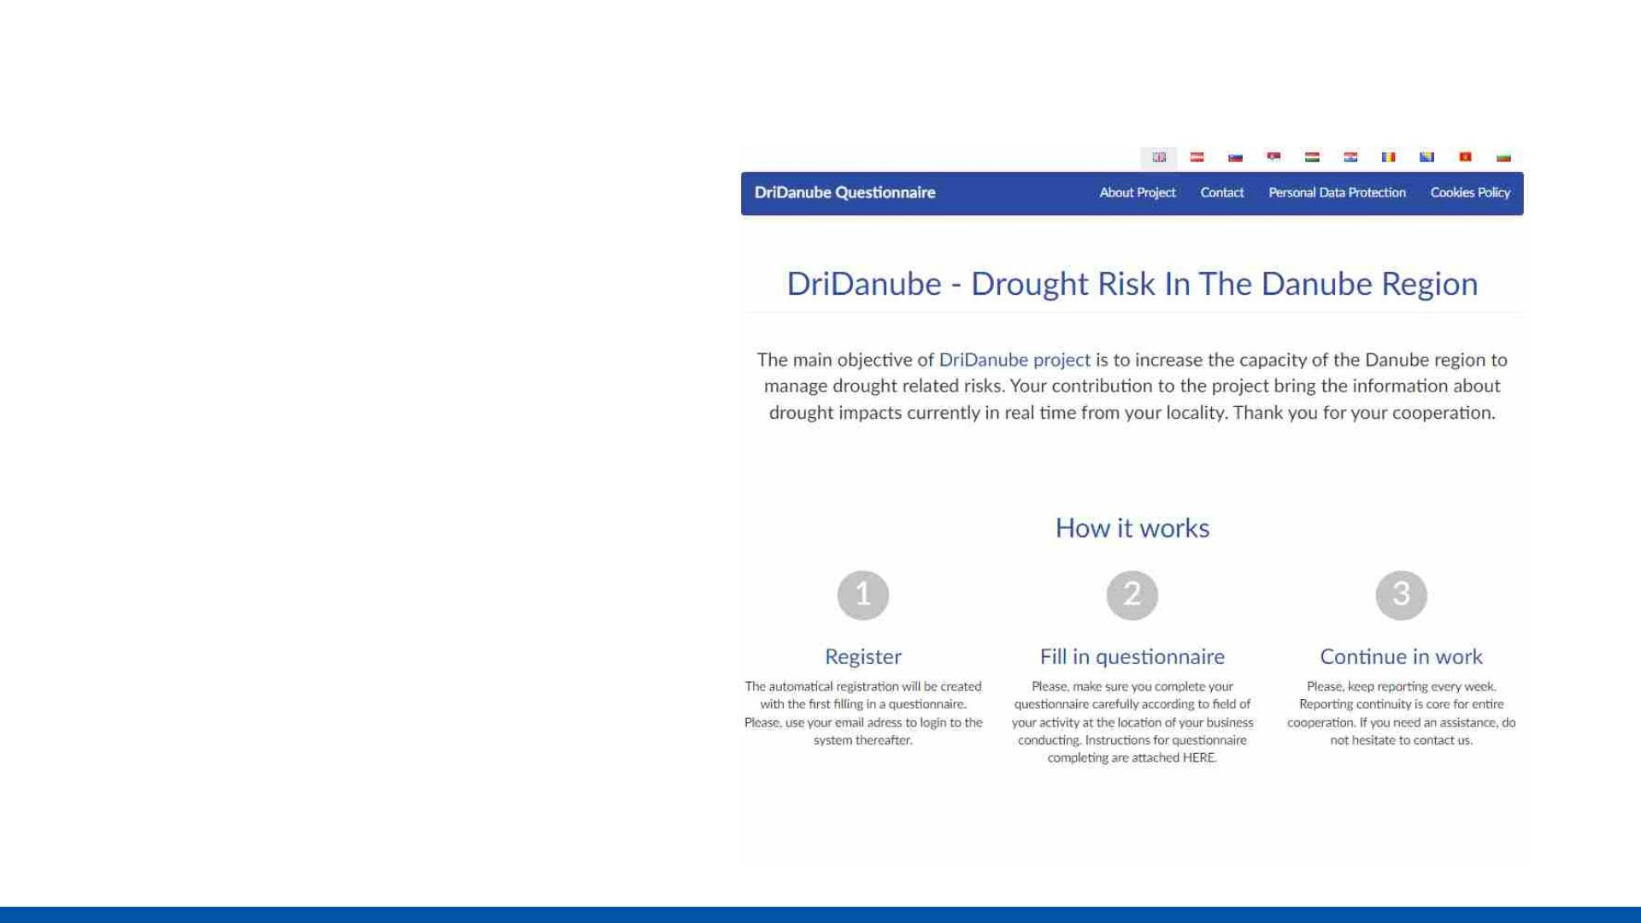
NRN for drought monitoring
• Whole system is
transferable to other
countries with different
needs
• Online questionnaire
already prepared and
easily adjustable to new
language and country
specifics
• https://questionnaire.inter
sucho.cz/en/

Slide 33
NRN for drought monitoring
?
• Not an easy or quick task
• How to engage reporters?
• Why should we try to build a reporting network?
• How to keep the network going?
• Can we trust reporters and their evaluations?
• Is it worth the effort?
• We are not so concerned about agriculture.
Who should we try to include in our network?

Slide 34
Why do we need reporters?
• Drought modeling and remote sensing does not bring enough
information about the occurrence or extent of drought impacts
• To bring a comprehensive picture, we need experts to evaluate
the impact in various fields
• With other methods, we lack the level of detail we can achieve
from cooperation with the network of local reporters
• In case of a drought event, we need to have information/data
ready and on hand
• We are building a network of contacts

Slide 35
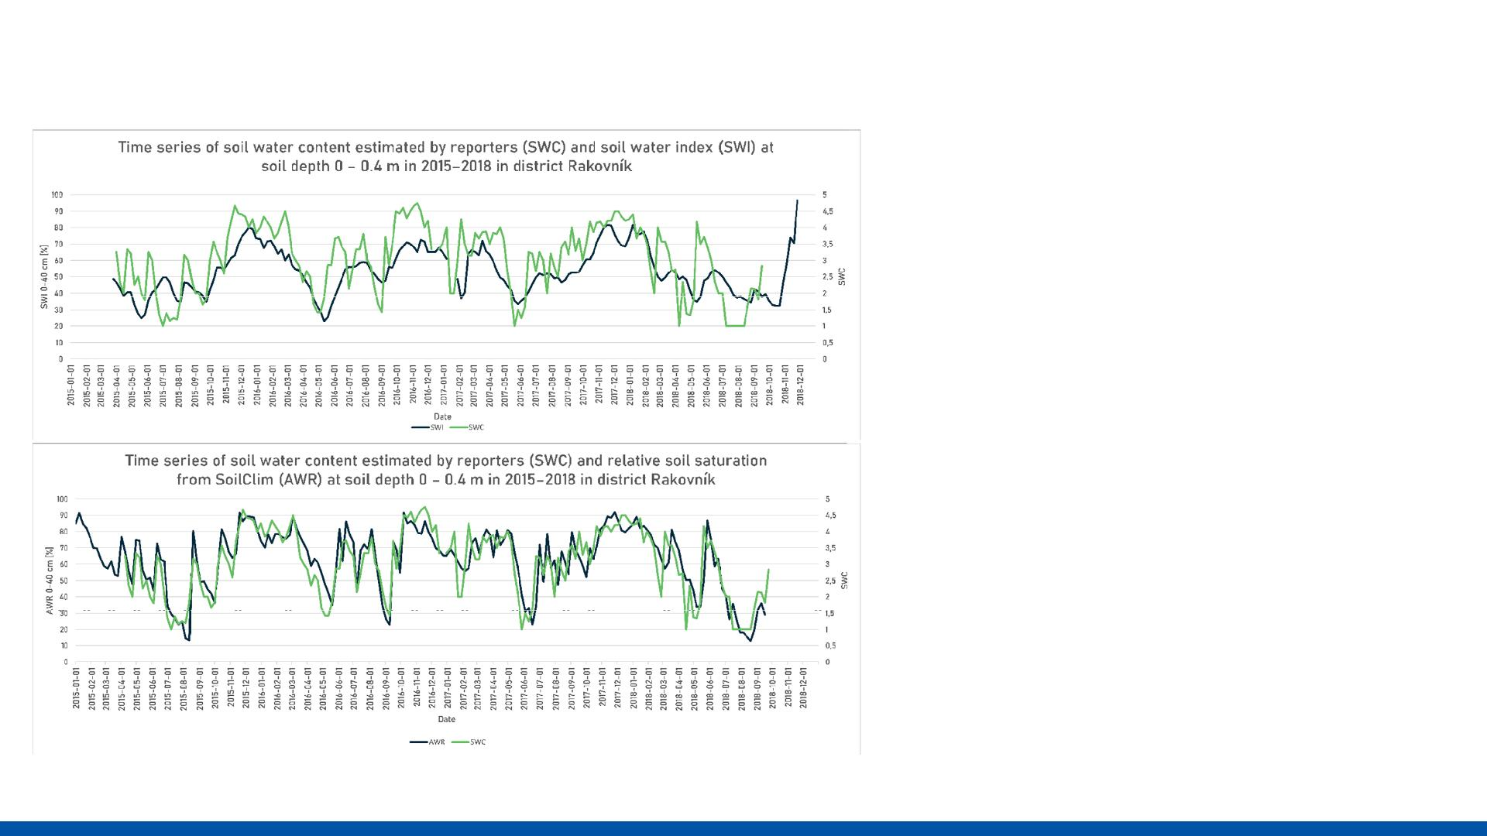
Can we trust reporters evaluation?
• Validity and reliability of
drought reporters in estimating
soil water content and drought
impacts in central Europe
• (Bartošová et al. 2022)
• Highlights
• Drought monitoring by voluntary
reporters is a valuable and
reliable tool.
• Reporters provide information
about the moisture status and
impacts of drought.
• Data by reporters were highly
correlated with models and
drought indices.
• Drought impact observations
could detect the start of a
drought earlier than the model.

Slide 36
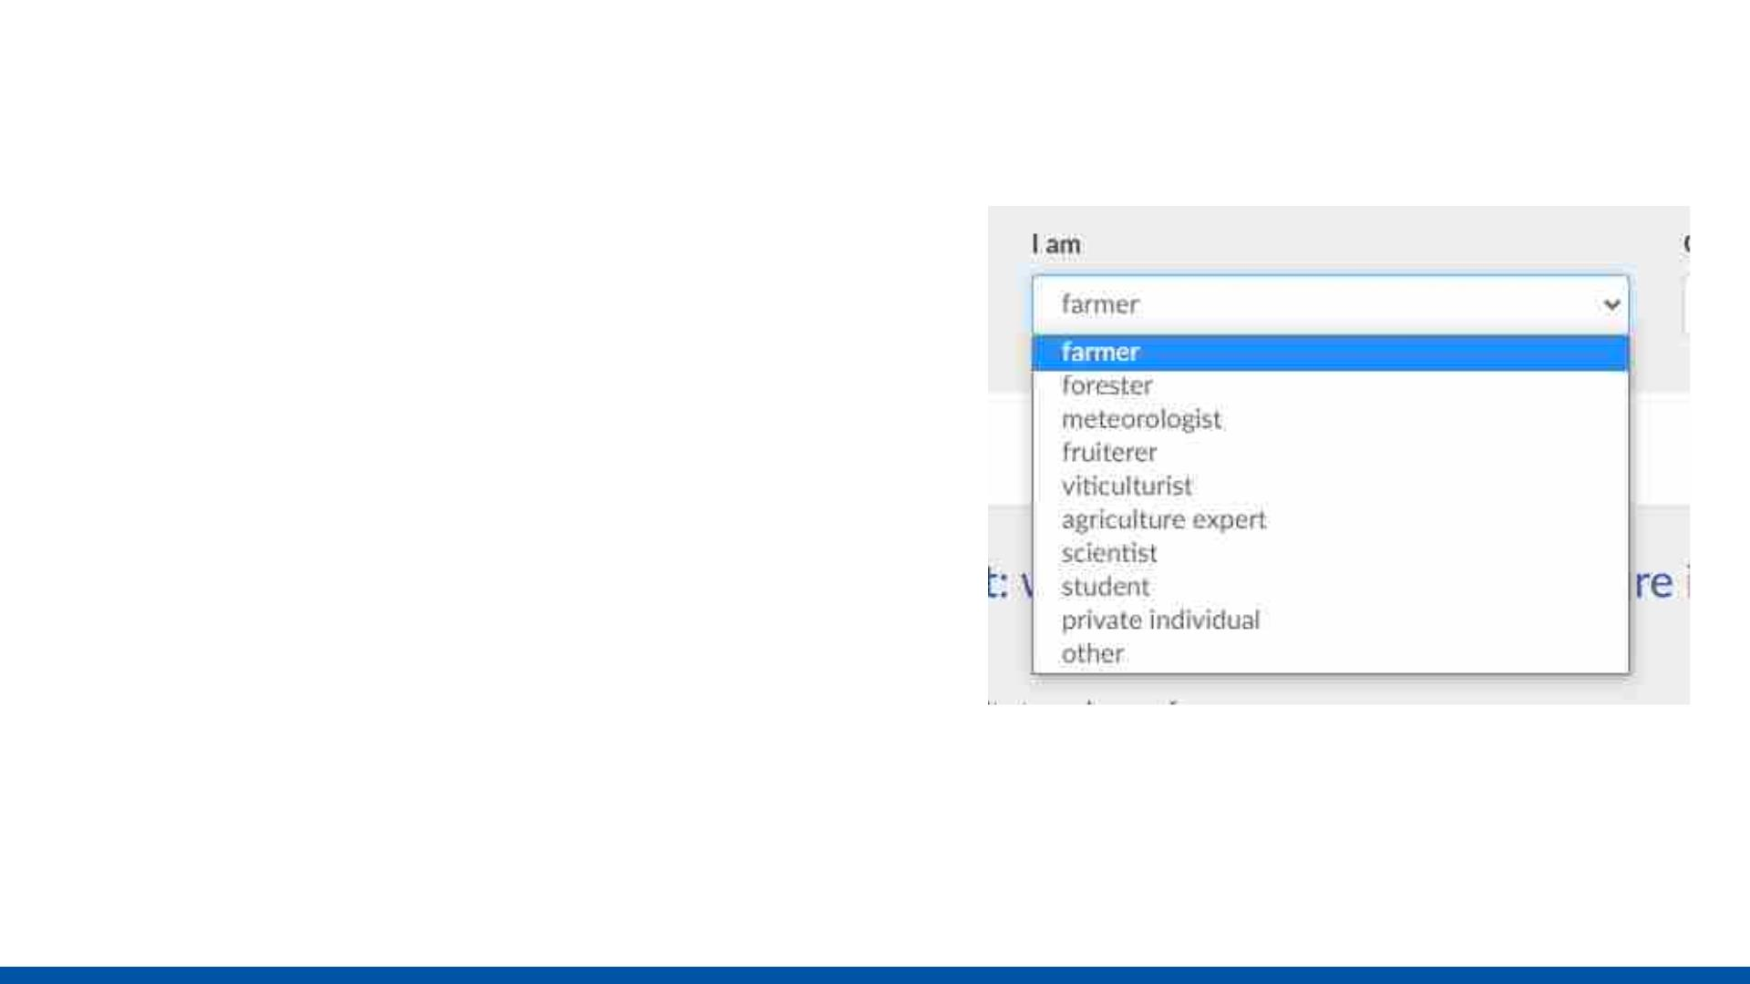
Who should be our reporters?
• Anyone ☺ Any group that makes sense in
your country
• Agriculturists
• Forestry experts
• Meteorologists
• Hydrologist
• Gardeners
• Livestock keepers
• Phenologists
• ?
• Soil drought is an essential factor in almost all
fields dealing with drought impacts
• Coumpound events connected to drought
are critical in almost every field

Slide 37
How to engage potential collaborators?
• When you reach your potential partner, it is recommended to
have something on hand
• First maps
• Website to support your network
• Questionnaire
• Meet your target group in person
• Discuss, explain
• Prepare strong arguments about why the NRN makes sense in
your country

Slide 38
What are the outcomes?
• Unique database with regular inputs
• Datailed maps
• Feedback for reporters
• Tool for promoting and spreading awareness and drought challenges
• Source of information supporting models, measurements and
satellite observations
• Building close connections with the most affected groups in your
regions
• Gaining full picture view of what is going on in your landscape

Slide 39
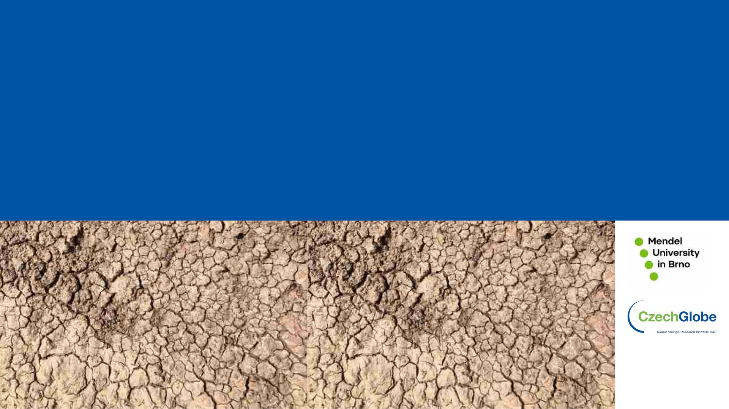
Thank you for your attention
Monika Bláhová
Global Change Research Institute CAS
blahova.m@czechglobe.cz

